Slide 1

Investment intelligence, engineered for precision.
Ohshn Intelligence LLP · Investor Deck
Nxance · Ohshn Intelligence LLP
01

Slide 2
WHO WE ARE
Nxance tells every Indian investor if their portfolio actually works — and exactly how to fix it.
VISION
Every rupee, properly understood.
Nxance · Ohshn Intelligence LLP
02

Slide 3
PROBLEM
Retail India invests blind, loses quietly, and has almost nowhere to turn for real advice.
21.6 Cr
9 in 10
< 1,000
demat accounts opened in India — most held by investors with no professional guidance on what's inside them.
individual F&O traders lost money in FY25 — a combined ₹1.06 lakh crore. Portfolios fail silently, for years, before anyone notices.
SEBI-registered investment advisers serve 20+ crore investors — roughly 1 regulated adviser per 2 million people.
Source: SEBI Monthly Bulletin, Depository Statistics, Dec 2025
Source: SEBI, "Analysis of Profit & Loss of Individual Traders in Equity F&O", Jul 2025
Source: The Ken, "SEBI-registered advisors are an endangered species", 2025
Nxance · Ohshn Intelligence LLP
03

Slide 4
SOLUTION
One app. Three engines.
Health Check, Construction, NxanceLM — AI that explains why.
1
Health Check
connects a user's existing holdings and runs 26 quantitative sub-engines: return performance (XIRR), risk (VaR, CVaR, Sharpe, Sortino, drawdown), diversification overlap (Jaccard similarity), hidden cost analysis, goal-alignment probability (Monte Carlo simulation across 10,000 market paths), macro regime sensitivity (Hidden Markov Models), news sentiment (FinBERT), and fraud/governance screening — producing a 0-100 health score with every issue explained and quantified in rupees.
2
Construction
26 sub-engines that build a new, optimized portfolio from a user's goals and risk profile using Mean-Variance Optimization (Black-Litterman + Ledoit-Wolf).
3
Nxance LM
An AI-powered explanation layer, plus a live market Terminal (Market, News, Macro, Currency sections). Health Check and Construction run their own independent, quantitative analysis end-to-end — Nxance LM then takes those verified results and explains them in plain English/Hindi, answers finance questions, and generates every report explanation the user sees. The Terminal is a separate, always-on feature showing live market data across each section, with an "Nxance Explain" toggle to overlay plain-language context on demand.
Measurable value: an instant, honest diagnosis where investors previously had none. Health Check and Construction run on 26 specialized sub-engines, and Every output includes supporting data, methodology and stated limitations—not just a black-box score.
Nxance · Ohshn Intelligence LLP
04

Slide 5
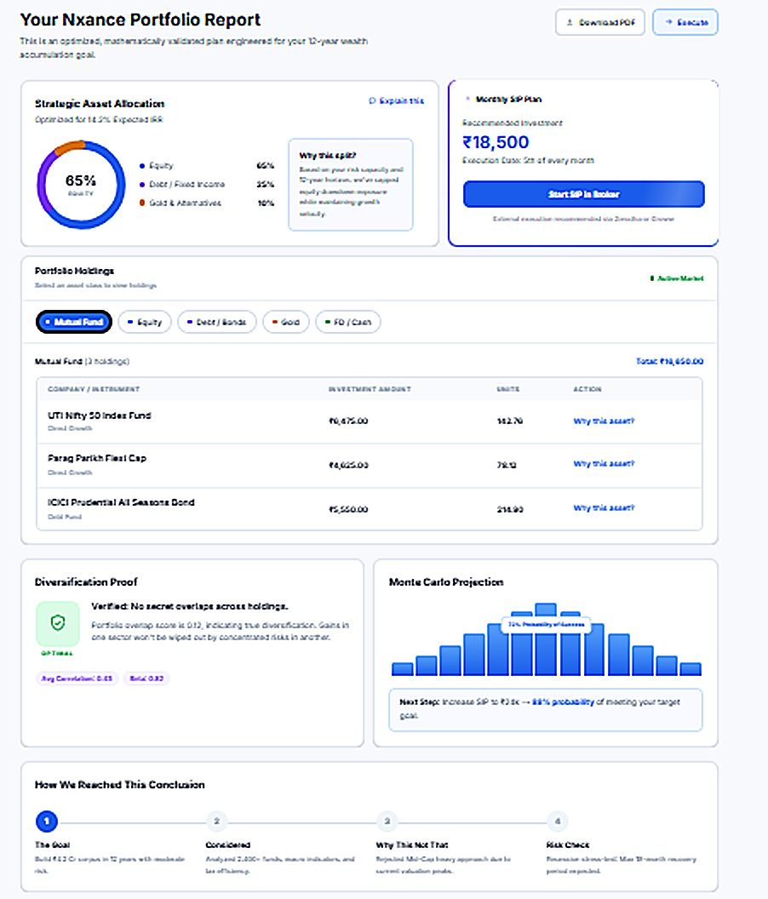
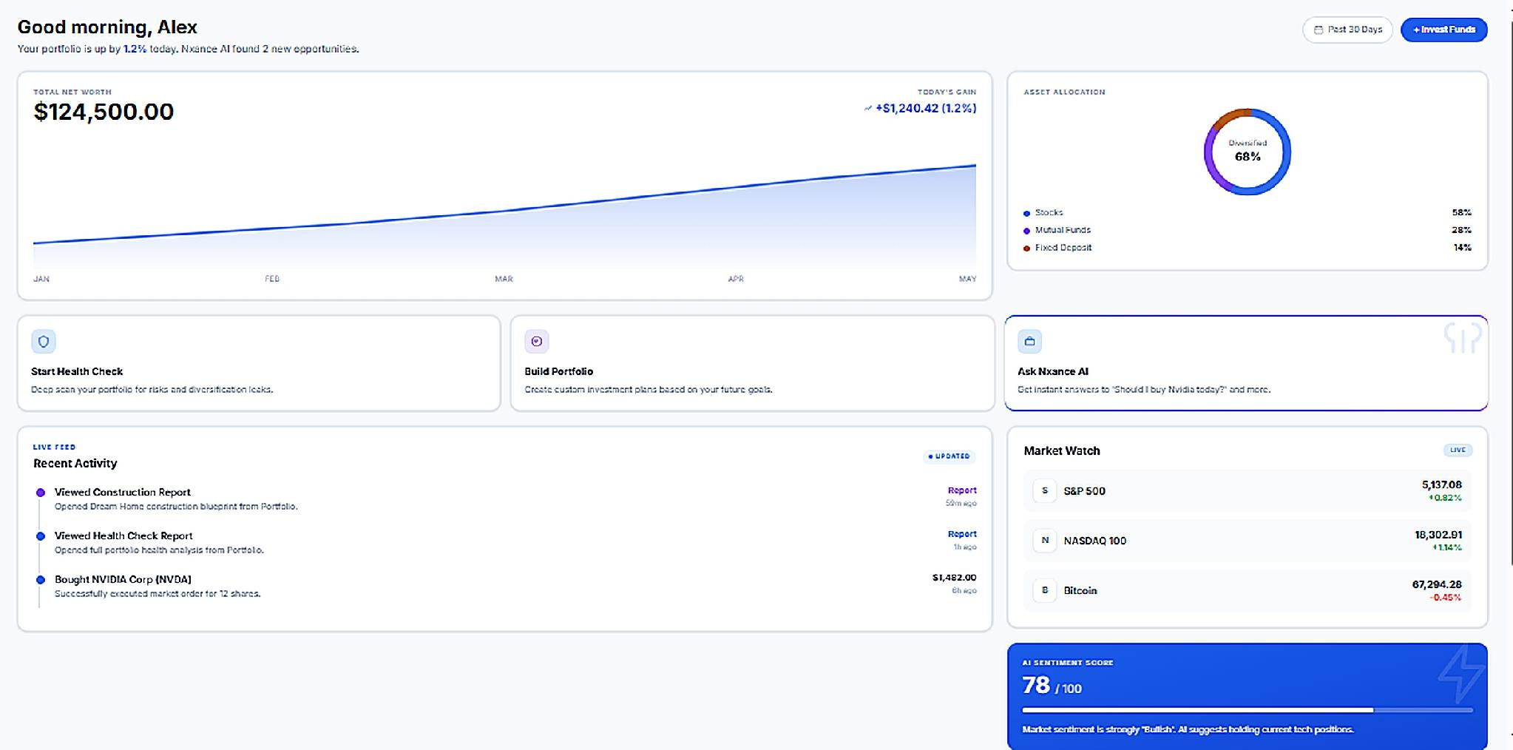
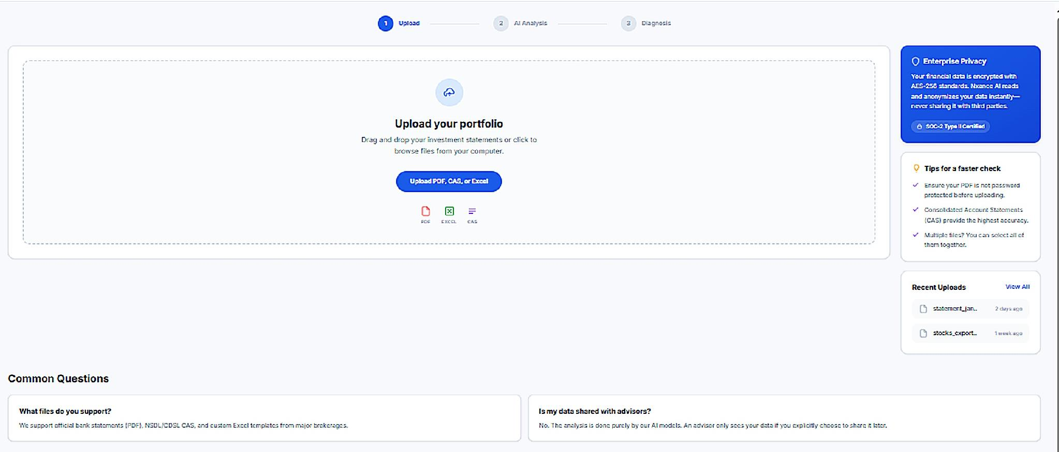
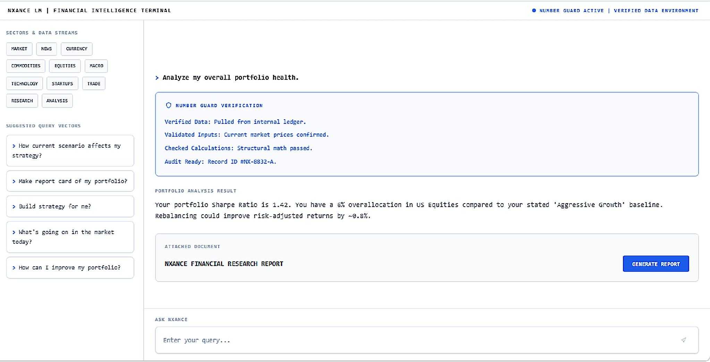
PRODUCT
What the Health Check, Portfolio Builder, and NxanceLM actually look like.
Portfolio Builder
Dashboard
Portfolio Builder — goal-based AI construction
Dashboard — net worth, allocation, AI sentiment
Health Check
Nxance AI
Health Check — upload & diagnose existing holdings
Nxance AI — conversational, explainable analysis
Nxance · Ohshn Intelligence LLP
05

Slide 6
TECHNOLOGY & AI ARCHITECTURE
Explainable AI on a lean, modern stack — built for traceable numbers, not invented ones.
End-to-end architecture & data flow
Portfolio Builder — goal-based intake feeds the AI construction engine (goal, risk profile, constraints).
Dashboard — aggregates net worth, allocation and AI sentiment for a live, continuous read of the portfolio.
Health Check — users upload holdings (PDF, CSV or Excel), which the engine parses and diagnoses.
Nxance LM— a conversational layer sits on top, so every screen can be interrogated in plain language.
Runs on a FastAPI + Supabase + Railway stack — built for a lean, subscription B2C SaaS product.
Where AI does the work
NXANCE LM pairs an integrated AI explanation layer with a fully functional, always-on Live Market Terminal — together in a single interface.
It does not merely aggregate data feeds. Health Check and Construction run their own independent, deterministic diagnostics and optimization — 26+ specialized sub-engines each, 52+ in total — computing every number directly from the user's data and live market inputs. The AI layer then takes those computed, verified results and turns them into deep, plain-language explanations in English or Hindi — backed by an audited evidence trail instead of opaque, "black-box" scores.
Conversely, when you need pure market analysis, the Terminal functions as a complete standalone workspace: click into any section — Market, News, Macro, or Currency — to instantly unlock a full-scale institutional platform where you track, analyze, and view raw, real-time data feeds. The specialized sub-engines run silently in the background, so you can click the "Nxance Explain" toggle at any time to instantly overlay plain-language logic and an explicit evidence trail directly onto the live charts.
.
Portfolio Builder · Health Check · Dashboard
26+ analytical engines
NxanceLM — 18+ explainable engines
FastAPI · Supabase · Railway
Traceable recommendation + reasoning
06
Nxance · Ohshn Intelligence LLP

Slide 7
EARLY VALIDATION
It started with one question:
"Is my portfolio working?"
12
8
50
investor conversations to pressure-test the problem
said they would pay for a real, honest answer
early users tested our working Construction engine prototype
So we built the engines — and are now taking the validated demo to a launch-ready product.
Nxance · Ohshn Intelligence LLP
07

Slide 8
Key Metrics & Validation
PROOF SO FAR, AND WHAT WE TRACK NEXT
Every phase has a named KPI gate before the next budget releases.
VALIDATED SO FAR
KPI GATES BY PHASE (NEXT 18 MONTHS)
• 12 investor/user conversations pressure-tested the core problem
• 8 of those 12 said they would pay for a real, honest answer
• 50 early users walked through a working engine demo end-to-end
• 500 users signed up on the pre-launch waitlist
• Full clickable frontend prototype built across all 3 engines
Phase | Key Validation Metric
Foundation (M1–3) | 100 interviews; 30–50 active testers
Alpha (M4–6) | 100+ completed analyses; 40% repeat usage
Closed Beta (M7–9) | 300–500 users; 25–50 paying users
Public V1 (M10–12) | 1,000+ users; early recurring revenue
Simulation Alpha (M13–15) | 2 design partners; validated scenario library
Institutional Scale (M16–18) | 3 institutional pilots; 5,000 users target
Nxance · Ohshn Intelligence LLP
08

Slide 9
MARKET
India's wealth is financialising fast — and the intelligence layer hasn't kept up.
$1.1T → $2.3T
21.6 Cr
₹26,400 Cr
India wealth management AUM, FY24 → FY29
demat accounts in India, growing by ~1 lakh a day
monthly SIP inflows into mutual funds, up from ₹3,100 Cr in 2016
Source: Deloitte India, "Financial Wealth Management Services in India", Jan 2025
Source: SEBI Chairperson, India International Trade Fair remarks, Nov 2025
Source: AMFI, Monthly SIP Contribution Data
Nxance · Ohshn Intelligence LLP
09

Slide 10
MARKET SIZE
TAM / SAM / SOM, and who is already paying for this kind of intelligence.
TAM
SAM
SOM
$2.3T
21.6 Cr
4.52 Cr
Total India wealth management AUM opportunity by FY29
Demat account holders investing largely without a regulated adviser
Active trading accounts today — our reachable base for a paid subscription
Deloitte India, Jan 2025
SEBI Depository Statistics, Dec 2025
NSE broker data via Angel One, Oct 2025
At just 0.5% conversion of active trading accounts to a ₹499–999/month subscription, the reachable revenue opportunity already exceeds ₹100 Cr ARR. Retail India is already paying for adjacent intelligence: INDmoney's tracking & AI advisory serves 10M+ users, Dezerv's portfolio health check has 6 lakh+ investors, and Wright Research's AI-driven advisory serves 1.5 lakh investors.
Sources: INDmoney (App Store, 2026) · Dezerv (App Store, 2026) · Wright Research (App Store, 2026)
Nxance · Ohshn Intelligence LLP
10

Slide 11
Customer Segments & Market Size
WHO WE SERVE, AND HOW BIG THE OPPORTUNITY IS
Every investor from first SIP to HNI — in a market already large and financialising fast.
CUSTOMER SEGMENTS
MARKET SIZE
Self-directed retail investors
First-time and existing demat holders investing without any professional guidance — the primary segment.
TAM
SAM
SOM
$2.3T
21.6 Cr
4.52 Cr
Active traders
Equity & F&O traders who need an honest, unbiased read on why a portfolio is or isn't working.
Total India wealth-management AUM opportunity by FY29
Demat account holders investing largely without a regulated adviser
Active trading accounts — our reachable base for a paid subscription
HNI / affluent investors
Want deeper, explainable analysis beyond a generic robo-advisor score.
At just 0.5% conversion of active trading accounts to a ₹499–999/month subscription, the reachable revenue opportunity already exceeds ₹100 Cr ARR.
B2B (future)
RIAs, boutique wealth firms and distributors licensing the underlying engines.
Retail India is already paying for adjacent intelligence: INDmoney's tracking & AI advisory serves 10M+ users, Dezerv's portfolio health check has 6 lakh+ investors, and Wright Research's AI-driven advisory serves 1.5 lakh investors.
Nxance · Ohshn Intelligence LLP
11

Slide 12
VISION & ROADMAP
Every rupee, properly understood.
Next major milestones
Scalability: one engine, every customer layer
1
Ship the free Health Check
Prototype is built today — the instant diagnosis is the free hook and paid-intent qualifier.
Retail
Advisors
Institutions
1
2
Open tiered subscriptions
Starter ₹399, Growth ₹899, Pro ₹1,499/mo — unlocking Construction, deeper NxanceLM, rebalancing and execution.
Shared platform infrastructure enables scale across customer layers, while AI, data, support and compliance costs are actively managed.
Long-term vision
Become the intelligence layer behind India's financialising wealth — the one place any investor, from first SIP to HNI, goes to know if their money is actually working.
3
Layer HNI & B2B revenue
Direct HNI advisory fees and licensing the engines to distributors and institutions as usage data compounds.
Nxance · Ohshn Intelligence LLP
12

Slide 13
PRODUCT & MONETIZATION
Frontend built. Free hook, tiered depth, then the rest of the wallet.
PRODUCT STATUS Frontend complete · Backend build next
1
Free Health Check
Hooks users with an instant, honest diagnosis of their existing portfolio. A ₹99 one-time unlock for the full report acts as the paid-intent qualifier.
2
Tiered subscriptions
Starter ₹399/mo, Growth ₹899/mo, Pro ₹1,499/mo — unlocking Construction, deeper NxanceLM access, rebalancing, execution and priority support as tiers climb.
3
HNI fees & B2B licensing
Layer on top as the user base and behaviour data compound — direct HNI advisory fees and licensing of the engines to distributors and institutions.
18-month revenue trajectory: 75 → 600 → 2,200 paying subscribers, ₹76.05L gross revenue collected (6.8% of the 18M operating burn) — modeled as upside, not netted against the funding ask.
Nxance · Ohshn Intelligence LLP
13

Slide 14
COMPETITIVE LANDSCAPE
Nobody else starts with diagnosis, explains its reasoning, and charges a flat fee for it.
Kalpi.ai
Wright Research
Ionic Wealth
MyFi
Nxance
Target user
Self-directed investors building strategies
Investors wanting managed money (RIA/PMS)
HNI/UHNI investors (₹1Cr–25Cr segment)
Retail MF/stock investors wanting a review
Every investor, first SIP to HNI
Pricing
Free to start; premium tiers
Advisory/PMS fees (~1.5–2% AUM)
PMS/AIF advisory fees; accredited-investor gated
Free; monetised via lending (MyCash)
Flat ₹499–999/mo — no asset-based fees
AI capability
Rule-based strategy builder
AI/ML factor models for managed portfolios
Ionic Wealth AI: institutional-grade insights on synced MF history, HNI-only
AI chat on fund review scores
52+ sub-engine (healthcheck and construction )s + NxanceLM (18+), fully explainable - Nxance LM - AI-driven market terminal giving clear evidence-backed insights.
Positioning
"Systematic investing" for DIY traders
"AI robo-advisor" managing money for you
Angel One-backed wealth platform for accredited/HNI investors
Portfolio review as hook into lending
Diagnosis-first, conflict-free, every investor
Dezerv (6L+ users) is HNI-oriented, AUM/advisory-fee, relationship-manager-led — referenced on the Market slide as demand proof, not listed here as a direct comparable. Sources: kalpi.ai · Wright Research (wrightresearch.in, smallcase, App Store) · Ionic Wealth (ionic.in, App Store, Hubbis) · MyFi (App Store) — company websites & public app listings, 2026
If a foundation-model provider shipped this feature tomorrow, why we still win: Product learning can improve the experience over time through explicitly consented, anonymised aggregate usage signals and robust
data-governance controls. Commission-free positioning is structurally hard for distributor-funded incumbents to replicate (trail commissions misalign their incentives), and it's hard for advisory-fee, human-heavy players like Ionic Wealth to match at a ₹499–999 flat price open to every investor, not just ₹1 Cr+ HNI portfolios.
14
Nxance · Ohshn Intelligence LLP

Slide 15
OUR USP
What actually sets Nxance apart.
1
Diagnosis before advice
We start where the others don't: a fast, honest read of the portfolio you already have — before asking you to build or trade anything.
2
Explainable, not a black box
Every output includes supporting data, methodology and stated limitations—not just a black-box score.
3
Subscription, not commission
₹399–1499/month, flat. No AUM-based fees like Wright Research or Ionic Wealth, no lending cross-sell like MyFi — our incentive is your outcome, not your balance.
4
Broker- and asset-agnostic
Works across any broker or asset class, not locked into one execution rail like Kalpi's broker integrations or Wright's smallcase-only model.
Nxance · Ohshn Intelligence LLP
15

Slide 16
MOAT
Trackers show. Nxance diagnoses.
AI grounded in verified data
Behaviour data compounds with use
Structurally hard to copy
Every output is linked to underlying data, calculations and cited evidence. Generated explanations operate within defined guardrails and are presented with an evidence trail—not as a bare score.
Product learning can improve the experience over time through explicitly consented, anonymised aggregate usage signals and robust data-governance controls.
Commission-free positioning is difficult for distributor-funded incumbents to replicate — trail commissions misalign their incentives.
Nxance · Ohshn Intelligence LLP
16

Slide 17
Current Status/ Stage
Prototype, validated — backend build is the next milestone.
1
Frontend prototype complete
A full clickable frontend across all three engines — Health Check, Construction, NxanceLM — is built and demoed, though not yet public.
1
2
Backend is the funded milestone
The quant/ML computation engines and Number Guard verification layer are the next build step, funded by this raise, per the 18-month phased roadmap.
3
Validated with real users
12 investor/user conversations pressure-tested the problem; 50 early users walked through a working demo; 500 users have joined the pre-launch waitlist.
4
Legal entity in place
Ohshn Intelligence LLP incorporated July 2026; conversion to Private Limited planned at funding close.
Nxance · Ohshn Intelligence LLP
17

Slide 18
TEAM
Four founders, one product — full-time on Nxance.
A
Abhishek
R
Raghav Kripasthya
Founder & CEO
Co-Founder & CTO
Investment analyst and product builder at the intersection of markets and technology. Trades equity & derivatives, has managed live portfolios, and has driven sales strategies that consistently exceeded targets.
AI engineer and data scientist building intelligent systems across healthcare, defense, computer vision, and automation. Hands-on across Python, PyTorch, TensorFlow, AWS and full-stack development.
linkedin.com/in/abhishek-rajput-4913bb195
linkedin.com/in/raghav-kripasthya-406a28261
D
Deepesh Khemka
B
Bhaskar Pandey
Co-Founder & CIO
Co-Founder & COO
CFA Level III (charter pending) with deep capital markets expertise, having built and scaled businesses before moving into wealth management. Leads investment strategy and client engagement.
Multidisciplinary founder and technology strategist across AI/ML, enterprise automation, and large-scale data platforms. Shipped 28+ npm packages for AI automation and workflow tooling.
linkedin.com/in/deepesh-khemka
linkedin.com/in/bhaskar-pandey-a9b23018b
Nxance · Ohshn Intelligence LLP
18

Slide 19
TEAM & HIRING PLAN
25 roles, 40-person capacity — built in step with the roadmap.
40
₹37.85L
₹583.10L
25
Exit headcount capacity (people)
Exit monthly payroll (Month 18) (/month)
Budgeted people & team pools (18-month cost)
Explicit hiring lines in the budget (cost pools)
Function
18M Cost (₹L)
% of pool
Hires start
Investment & Research
250.5
43.0%
M1 (trader) → M12 (global mkt)
Leadership (Founders)
94.5
16.2%
Day 1
Technology
76.0
13.0%
M1 (QA) → M5 (cyber, BE2)
Quant & Research Ops
64.0
11.0%
M1 (engines) → M10 (research)
Sales & Customer Success
52.1
8.9%
M2 (ground team) → M3 (support)
AI / ML
36.0
6.2%
Day 1
Compliance
10.0
1.7%
M9 (post-RIA readiness)
Full 25-line role-by-role hiring schedule, start month and trigger milestone available in the detailed budget model.
Nxance · Ohshn Intelligence LLP
19

Slide 20
SCALABILITY
Software margins. Zero marginal cost.
One engine. Every customer layer.
Retail
→
Advisors
→
Institutions
Shared platform infrastructure enables scale across customer layers, while AI, data, support and compliance costs are actively managed.
Nxance · Ohshn Intelligence LLP
20

Slide 21
Unique Value proposition
WHAT ACTUALLY SETS NXANCE APART
Every investor gets a diagnosis first, an explainable answer, and a flat fee — not a black box or a commission.
1
Diagnosis before advice
Starts where others don't: a fast, honest read of the portfolio an investor already has — before asking them to build or trade anything new.
2
Explainable, not a black box
Every output carries supporting data, methodology and stated limitations, enforced by a Number Guard that blocks any AI-generated figure the engines didn't compute.
3
Subscription, not commission
Flat ₹399–1,499/month. No AUM-based fees like advisory-fee competitors, no lending cross-sell — the incentive is the user's outcome, not their balance.
4
Broker- and asset-agnostic
Works across any broker or asset class, not locked into one execution rail or a single model-portfolio format.
Nxance · Ohshn Intelligence LLP
21

Slide 22
Channels
GO-TO-MARKET
India-first, digital-led — a free hook that converts into paid depth.
1
Freemium Health Check
A free, honest diagnosis is the acquisition hook — organic app-store and web sign-ups convert through the ₹99 unlock into subscriptions.
2
Digital & performance marketing
Targeted acquisition across search and social, aimed at self-directed retail investors and demat-account holders.
3
Investor communities & financial educators
Presence in trading/investing communities (Telegram, Reddit, YouTube) and partnerships with financial educators who already reach this audience.Investor-education content and demat-holder communities build organic reach.
4
In-app upgrade
Diagnosis surfaces the gap; Construction & NxanceLM sit behind the paid tiers.
5
Strategic & distribution partnerships
Brokers, fintech apps and distributors as an embedded/B2B channel once the core B2C product is proven.
Nxance · Ohshn Intelligence LLP
22

Slide 23
WHY NOW
Payments disrupted. Lending disrupted.
Wealth intelligence: still empty.
The AI moment meets the retail boom.
$112B → $550B
India's fintech market, 2024 → 2030
Source: TechSci Research, India FinTech Market Report
Nxance · Ohshn Intelligence LLP
23

Slide 24
THE ASK
₹12.49 Cr for 20% equity — a ₹49.95 Cr pre-money valuation.
Post-money valuation ₹62.44 Cr · Investor ownership at close 20.0%
₹12.49
18
6.8%
crore
months
of burn
Recommended funding ask
Runway funded
Revenue offset (upside, not netted)
18-month operating burn + refundable reserve + 12% contingency
From MBP build through Public V1 and institutional-pilot readiness
₹76.05 lakh gross subscription revenue projected over the same period
Capital funds the full 18-month build — MBP through regulated beta, public launch, and the first institutional pilots — with revenue treated as upside, not a runway offset.
Nxance · Ohshn Intelligence LLP
24

Slide 25
USE OF FUNDS
How the ₹12.49 Cr gets deployed.
Based on the 18-month management budget — investor use-of-funds breakdown, before and including contingency.
27.7%
Technology & AI
6.1%
Organization & Office
₹345.30L
₹76.20L
Cloud, AI/LLM, APIs, engineering, DevOps, tools and compute
Bengaluru office, email, infra, tools and administration
23.6%
Investment & Research
7.6%
Founder / Leadership
₹294.50L
₹94.50L
Quant, portfolio, research, risk, market and compliance expertise
Four founder cash draws across the full 18-month runway
17.1%
Marketing & Branding
4.2%
Sales & Customer Support
₹213.90L
₹52.10L
Social, ads and media ramp
Ground/call team and customer support
10.7%
Contingency Reserve
2.3%
Compliance & Licence
₹133.25L
₹29.15L
12% of operating burn — protects runway from budget variance
RIA prep, legal/CS/audit, DPDP, trademark, regulatory buffer
18-month operating burn ₹11.11 Cr + ₹5.00 lakh refundable SEBI-RIA deposit + ₹1.33 Cr contingency reserve = ₹12.49 Cr recommended ask. Subscription revenue (₹0.76 Cr projected) is shown as upside, not netted against the ask.
Nxance · Ohshn Intelligence LLP
25

Slide 26
18-month plan
  DEVELOPMENT, FINANCIAL & REVENUE ROADMAP
Front end fully built today. ₹12.49 Cr funds the 18-month build to institutional scale — with development, burn and revenue tracked phase by phase.
Phase | Development & Build | Financial Plan | Revenue Plan
Foundation M1–3 | Portfolio import, health score & analytics engine; admin QA. Hires: CTO, engineers, ML, quant. | MBP build budget released. Pre-launch — no revenue offset yet. | Pre-revenue: validating with 30–50 active testers.
Alpha M4–6 | Risk profiling, suitability workflow, Monte Carlo & human review. Hires: QA, DevOps/security. | Regulated-beta budget released on SEBI-readiness gate. | Milestone 1 (M1–5): 75 subscribers · ₹1.61L collected.
Closed Beta M7–9 | Payments, recommendations, model monitoring & support workflows. Hires: 2nd backend + ML engineer. | Public-launch budget released on retention/paid-conversion gate. | Scaling toward Milestone 2 (600 subscribers by M12) as early retention data validates.
Public V1 M10–12 | Scalable production build, portfolio monitoring & reporting. Hires: 2nd customer-success. | Simulation-phase budget released. | Milestone 2 (M6–12): 600 subscribers · ₹14.46L collected.
Simulation Alpha M13–15 | Market replay, synthetic scenarios, behavioural agents, stress tests. Hires: simulation scientist. | Institutional-pilot budget released. | Building toward Milestone 3; 2 design partners onboarded.
Institutional Scale M16–18 | Advisor + simulation platform, APIs, enterprise dashboards. Team scales to 40 people. | Peak burn ₹76.91L/mo. 18-month burn ₹11.10 Cr + reserve → ₹12.49 Cr ask. | Milestone 3 (M13–18): 2,200 subscribers · ₹59.98L collected → ₹76.05L total (6.8% of burn).
18-month build funded by a ₹12.49 Cr ask (₹11.10 Cr burn + ₹1.33 Cr contingency + ₹5L refundable SEBI-RIA deposit) · average burn ₹61.97L/mo, peaking at ₹76.91L in Month 18 · revenue is modelled as upside: ₹76.05L collected (6.8% of burn) as subscribers scale 75 → 600 → 2,200.
26
Nxance · Ohshn Intelligence LLP

Slide 27
FINANCIAL OVERVIEW
18-month burn — building to a ₹76.9L/month run-rate by launch.
Peak month-18 burn ₹76.91L · Average burn ₹61.97L/mo · Total 18M requirement ₹1,248.70L (₹12.49 Cr)
Nxance · Ohshn Intelligence LLP
27

Slide 28
EXIT PLAN
Natural acquirers: brokers, AMCs, banks.
Strategic acquisition
Brokers, AMCs and banks already own the customer relationship Nxance makes stickier.
Wealthtech M&A
Recent wealthtech exits have typically traded at 8–15× revenue.
Long path: IPO
SEBI-RIA registration → scaled advisory book → public listing.
Required exit by target investor return — on ₹12.49 Cr invested at 20% (13.0% final ownership after future dilution)
Target MOIC
Required Exit (₹Cr)
5Y IRR
3.0x
288.16
24.6%
5.0x
480.27
38.0%
8.0x
768.43
51.6%
10.0x
960.54
58.5%
Illustrative target case · ₹750 Cr exit → 7.8x MOIC, 50.8% 5Y IRR
6× Year-5 revenue cross-check on the prior ₹62.90 Cr base case implies a ₹377.40 Cr exit (3.9x MOIC, 31.5% IRR) — the 10x target requires an exit closer to ₹960 Cr, or roughly 11.9× Year-5 revenue. Exit values are scenario sensitivities, not forecasts.
Nxance · Ohshn Intelligence LLP
28

Slide 29
Intelligence that leads to clearer decisions.
nxance.com · Ohshn Intelligence LLP
Nxance · Ohshn Intelligence LLP
29

